Slide 1



Ankira
Marketing plan
For Ankira platforms
2024
Ankira Co.
www.Ankira.com

Slide 2

Agenda
Introduction
Branding elements
1
7
Problem statement
SWOT analysis
2
8
Market Analysis
Marketing strategy
3
9
8ps
Ad report
4
10
Buyer persona
Our team
5
11
6
Business model

Slide 3
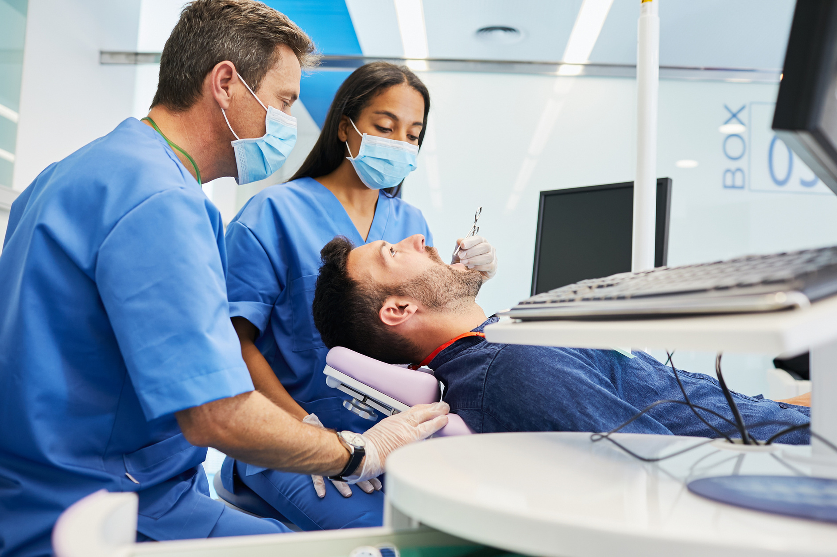

Introduction
Ankira specializes in providing affordable, high-quality dental care for clients from the U.S., particularly from California and Texas. Our services cater to the uninsured, cost-conscious patients, and the Arab community, connecting them with Egypt’s top dental professionals. We offer comprehensive packages, covering treatment, travel, accommodation, and more, ensuring a seamless experience. At Ankira, we combine exceptional dental care
with the chance to explore Egypt’s rich culture, delivering both healthy smiles and unforgettable memories.
Ankira Co. | 2024

Slide 4
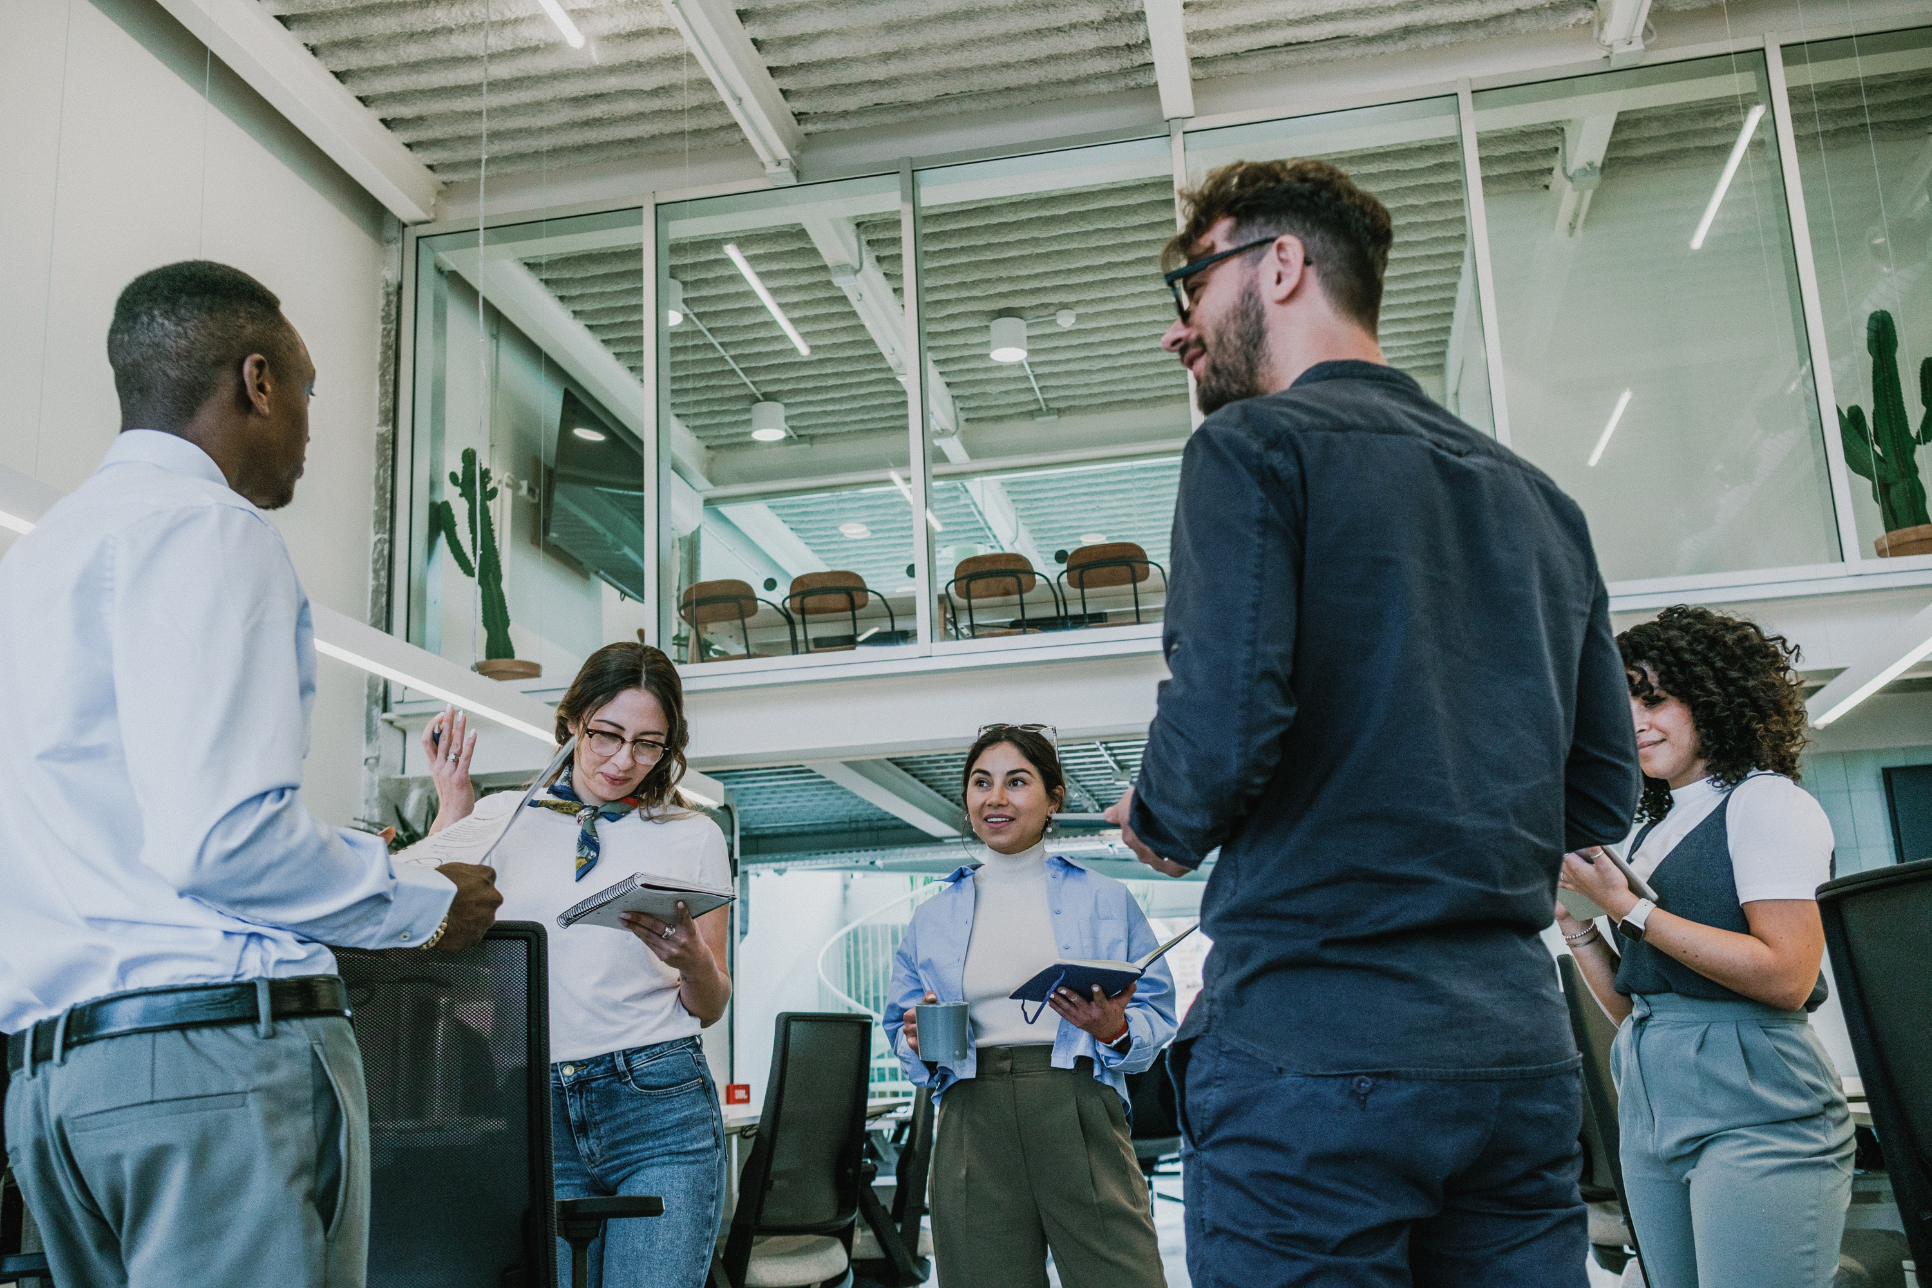
PROBLEM STATEMENT
problem
High costs of dental care in the U.S., especially in states like California and Texas, create a barrier for many Americans.
solution
Offer affordable dental treatments in Egypt
Provide an easy-to-use mobile application that connects patients with trusted Egyptian dentists.
Full-service platform that covers everything from consultation to booking flights, accommodation, and treatment appointments.

Slide 5








Marketing Analysis
STP
Competitors

Slide 6





Ankira
Targeting
Primary Segment
Secondary Segment
Health-Insured Quality Seekers
Seek high-quality medical treatments at competitive prices.
Can afford out-of-pocket expenses not covered by insurance.
Arab Community
Prefer treatment in culturally familiar environments with Arabic communication.

Slide 7
Ankira
Psychographic
Segmentation
Quality seekers, culturally connected travelers, price-sensitive individuals, those interested in combining tourism and medical treatment
Geographic
Demographic
California and Texas (USA)
Health-insured individuals, Arab community, uninsured individuals, budget-conscious travelers

Slide 8
Ankira
Positioning
California
Texas
Health-Insured Quality Seekers: Position Egypt as a destination for affordable, high-quality medical services that complement US health insurance coverage.
Arab Community: Emphasize cultural comfort, Arabic communication, and understanding of cultural values during treatment.
Uninsured Individuals: Highlight affordability, offering savings up to 70% compared to local healthcare services.
Budget-Conscious Medical Tourists: Promote Egypt as a destination where affordable healthcare meets leisure, emphasizing vacation-like treatment packages.

Slide 9

Marketing 8p’s

Slide 10


BUYER PERSONA

Slide 11


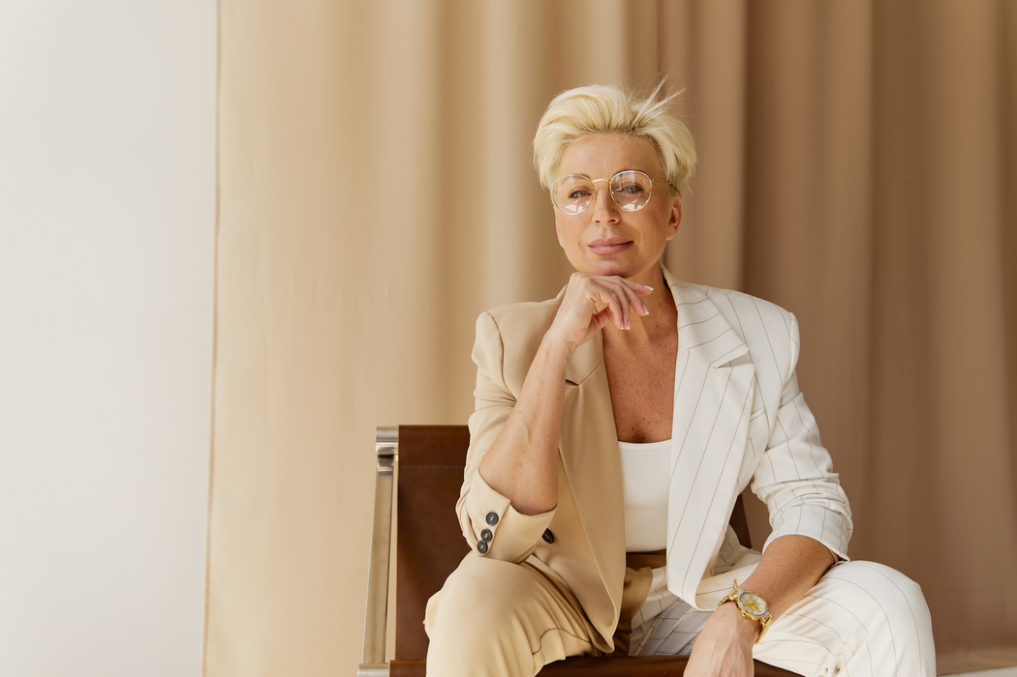

THE UNINSURED
INTERESTS | Family, getting by, simple pleasures, perhaps local community events.
CHALLENGES | Financial: Making ends meet, lack of health insurance, unexpected dental costs are devastating. Customer Service: Dealing with difficult customers all day.
STEPS TAKES TO FIX THAT | Seeks affordable treatment, may delay until it's unbearable. Wants clear pricing upfront, reassurance it's reputable.
GOALS | Get needed dental work done without going into debt. Improve oral health, maybe appearance as budget allows.
MOTIVATION | Primarily driven by need and cost-saving.
FRUSTRATION | US system is too expensive, feels left behind. May be wary of 'too good to be true' offers.
SOURCES OF INFO | Relies heavily on word-of-mouth from trusted people (friends, family, maybe local community figures). Some social media use, but likely for personal connection, not in-depth research.
ADDITIONAL. | Likely to be skeptical, needs a lot of hand-holding to feel secure in the process. Building trust is paramount.
NAME
Sara
AGE
52
LOCATION
California
OCCUPATION
Waitress
MARITAL STATUS
Divorced
KIDS
No
ANNUAL INCOME
$28,000

Slide 12
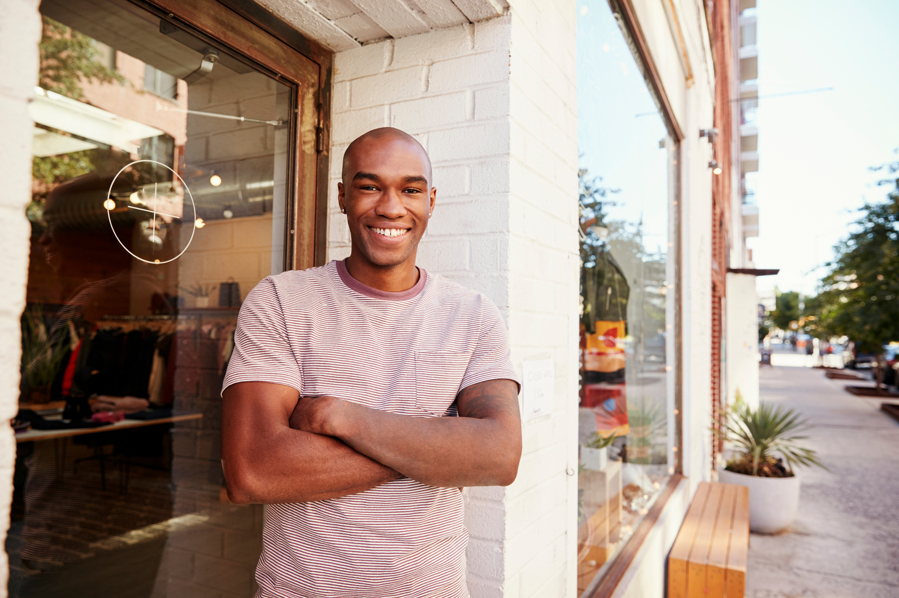
ARAB COMMUNITY
INTERESTS | Family, maintaining cultural ties, Arabic news/events, faith
CHALLENGES | Balancing demanding job with family obligations. Project management, team collaboration are key stressors.
STEPS TAKES TO FIX THAT | Seeks treatment that aligns with his values. Wants Arabic language support, may prioritize doctors who share his background.
GOALS | High-quality dental care at a good price. Combine treatment with visiting family in Egypt.
MOTIVATION | Blend of practicality (cost, quality) with cultural connection.
FRUSTRATION | US healthcare system may feel impersonal, communication barriers are a concern
SOURCES OF INFO | Arabic websites/forums, community members, perhaps professional associations.
ADDITIONAL. | Tech-savvy, but might not trust online reviews as much as personal recommendations. Building rapport is key.
NAME
Mohamed
AGE
45
LOCATION
California
OCCUPATION
Senior Software Engineer, mid-sized tech company
MARITAL STATUS
KIDS
Married
3
ANNUAL INCOME
$90,000

Slide 13
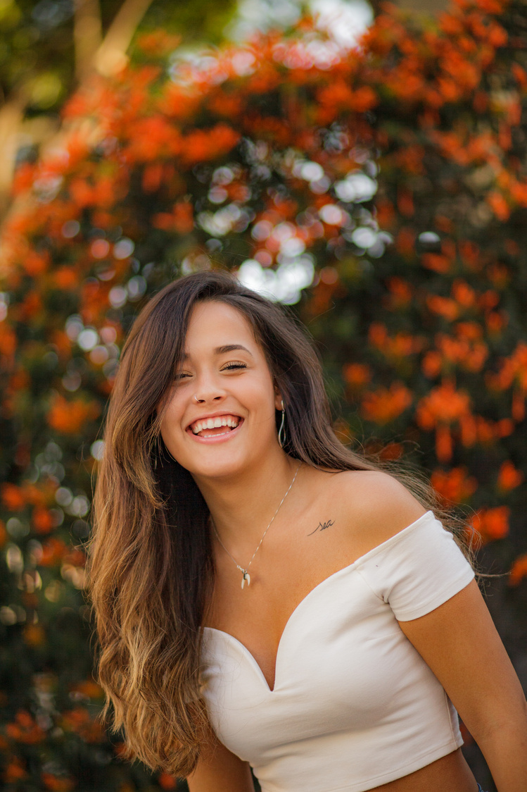
USER PERSONA 3
MARITAL STATUS | Married
KIDS | No
ANNUAL INCOME | $70.000
INTERESTS | Travel, new experiences, aesthetics, design, perhaps wellness/self-care trends.
CHALLENGES | Maintaining creative output, managing client expectations, staying on top of trends.
STEPS TAKES TO FIX THAT | Seeks a blend of quality treatment with a memorable trip. Open to new places, but wants a smooth, well-organized experience.
GOALS | High-quality dental care at a lower price than the US. Combine treatment with a vacation or cultural immersion.
MOTIVATION | wants the best of both worlds (treatment + travel).
FRUSTRATION | US dental costs are high, limited vacation time makes the most of it important
SOURCES OF INFO | Online travel reviews, design/travel blogs, perhaps recommendations from other "in-the-know" people.
ADDITIONAL. | Visually oriented, appreciates good design and communication. Showing, not just telling, is key to appeal.
NAME
Jennifer
AGE
40
LOCATION
Texas
OCCUPATION
Art Director

Slide 14
BUSINESS MODEL CANVAS

Slide 15









Business Model Canvas
- Hospitals and dental clinics in Egypt.
- Airline companies.
- Health insurance companies.
- High-quality medical services at a fraction of U.S. costs.
- Convenience of booking medical services and travel in one place.
- Partnerships with airlines for exclusive medical travel packages.
- Online customer support.
- Dedicated app to facilitate bookings and communication.
- Free online medical consultations.
Customer Relationship
Key Partners
Key Activities
Value Propositions
Customer Segments
- Developing and maintaining the application.
- Forming partnerships with clinics and hospitals.
- Marketing campaigns targeting the U.S. market.
- American citizens seeking affordable medical services, particularly dental treatments.
- Residents of Texas and California.
- Foreign tourists interested in medical tourism.
- Social media platforms (LinkedIn, Facebook).
- Digital ads targeting Texas and California.
- Partnerships with travel agencies and airlines.
Key Resources
Channels
- Partnerships with hospitals and clinics in Egypt.
- A user-friendly mobile application.
- Customer support and sales teams
Cost Structure
Revenue Stream
- Hospitals and dental clinics in Egypt partnerships.
- Airline companies and hotels partnerships.
Marketing and human resources
- .
- Booking fees for medical services.
- Commissions from airlines and travel agencies.
- Bundled medical packages, including treatment, accommodation, and travel.

Slide 16
BRANDING ELEMENTS

Slide 17


Slide 18


Slide 19
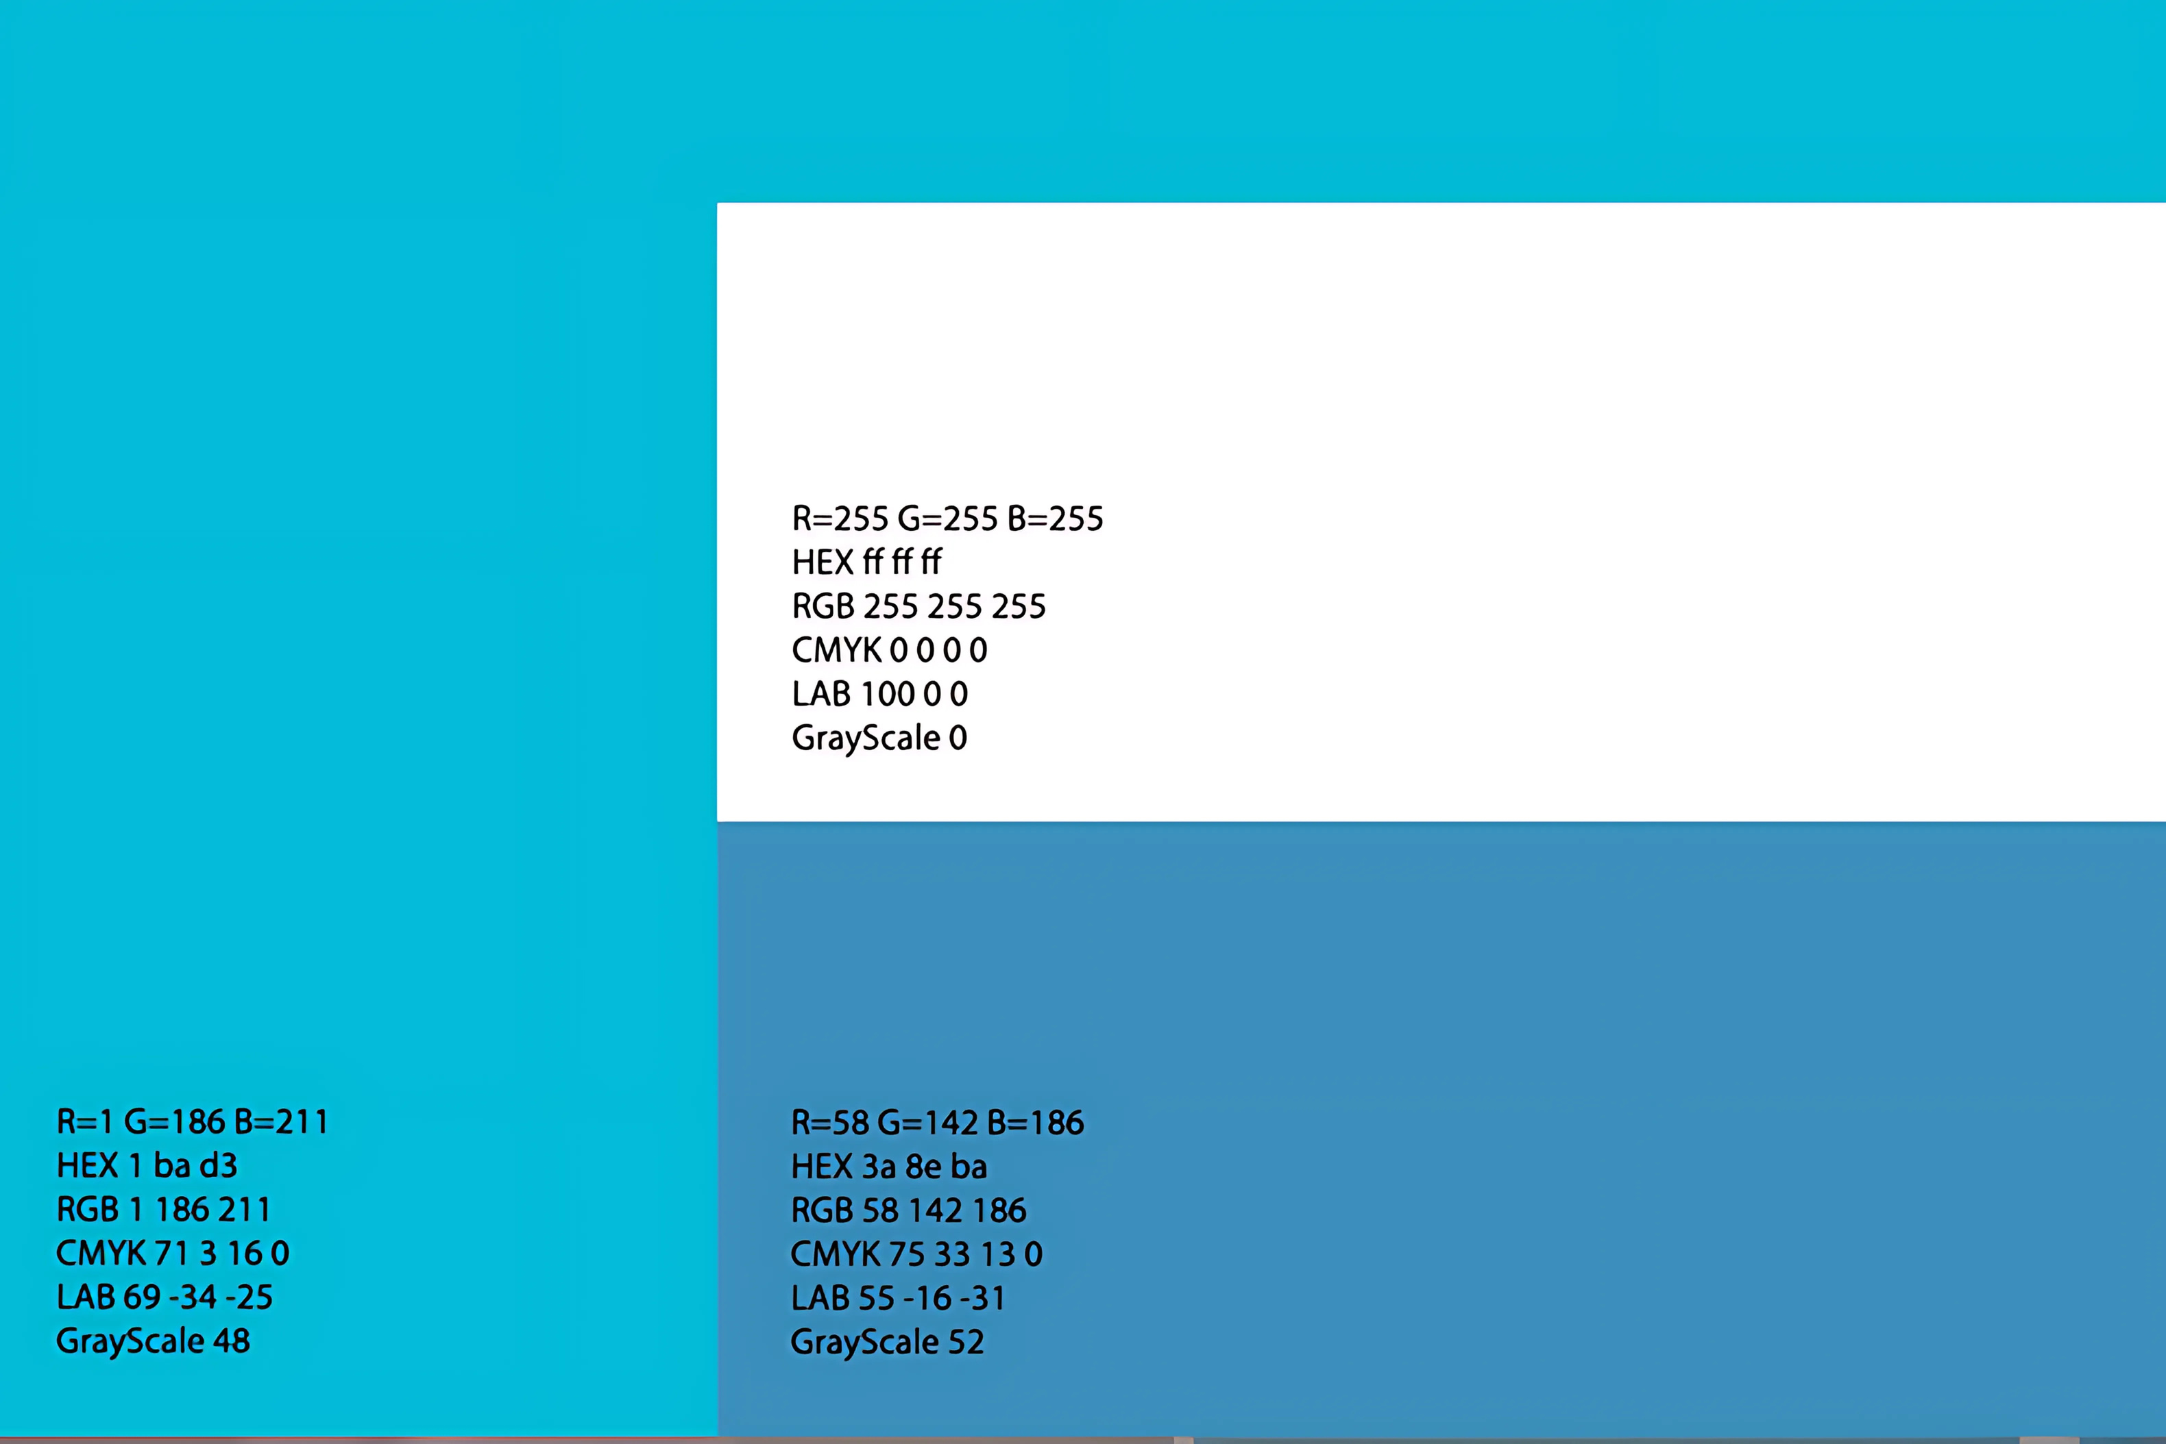

Slide 20
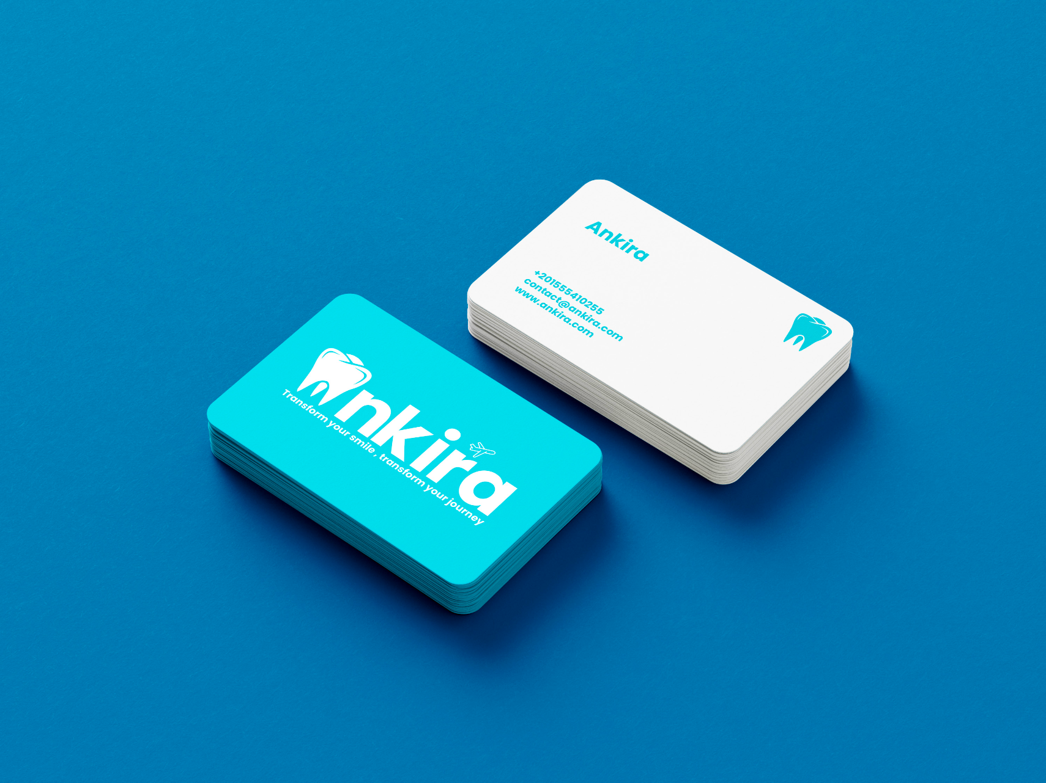

Slide 21
Strengths Competitive Pricing. High Quality of certain medical services (dentistry, cardiac, cosmetic). Strategic Location and direct flights from the US. Cultural and language familiarity for the Arab community. Wide range of additional services (flights, hotels, tours). Dedicated mobile application for easy booking and communication. |  | Weaknesses Negative image of some medical services in Egypt. Insufficient marketing reach in the US. Fierce competition from other medical tourism destinations.
Opportunities Growing demand for medical tourism globally. Expansion of online medical services market. Potential partnerships with insurance companies. Collaboration opportunities with travel agencies. |  | Threats Unstable political and economic conditions in the Middle East. Currency exchange rate fluctuations. Emergence of new competitive destinations. Changing medical tourism laws and regulations. Potential impact of pandemics and infectious diseases.
S
W
S
O
T

Slide 22

ANKIRA CO.
Marketing Strategy

Slide 23


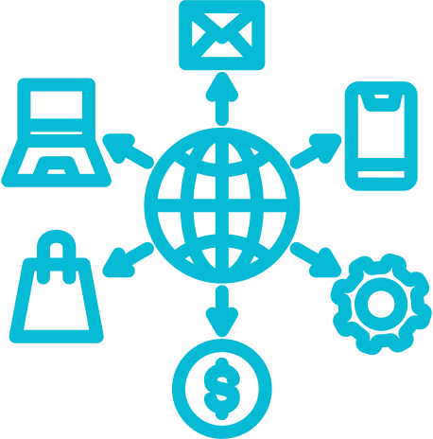


OUR DIGITAL MARKETING CHANNEL
SOCIAL MEDIA
landing page
Influncer Marketing and YV ads
SEO / SEM
Email Marketing
Affiliate marketing program

Slide 24



ANKIRA CO.
social media channels
Meta
Linkedin
Tiktok
Ankira co.. | Social Media Strategy

Slide 25
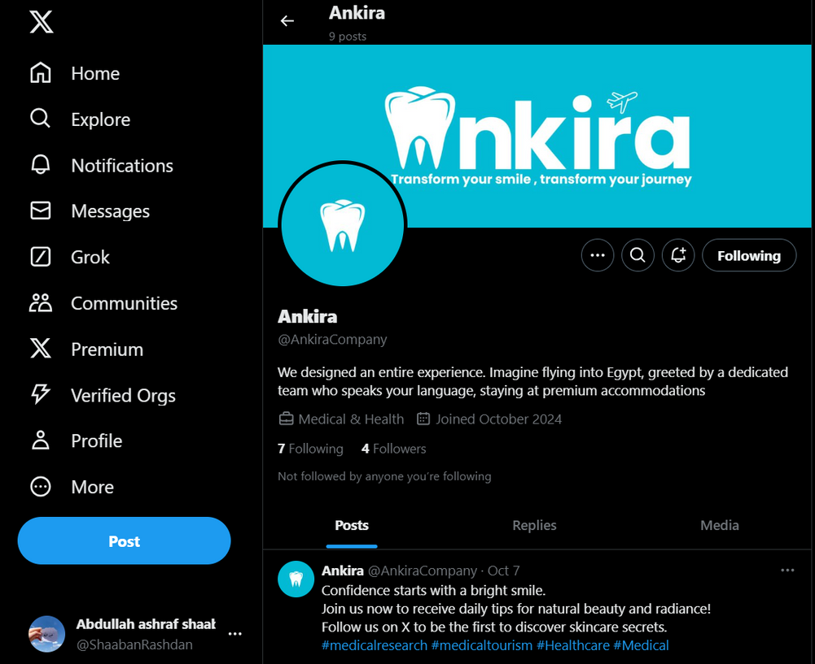
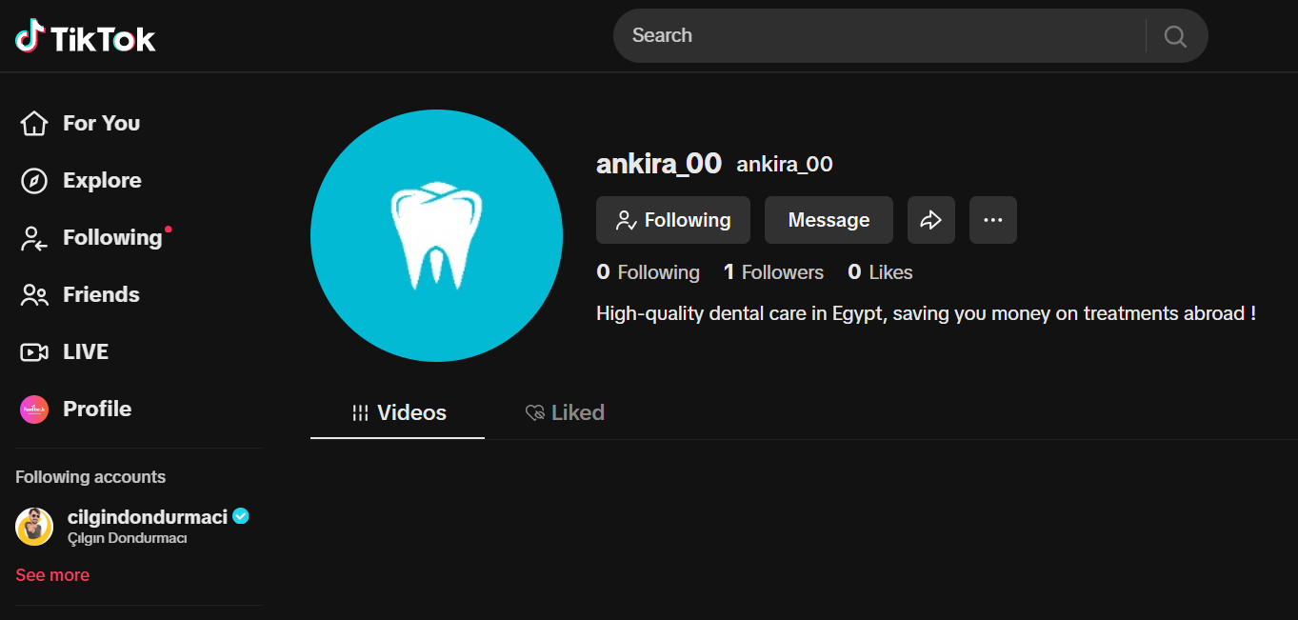
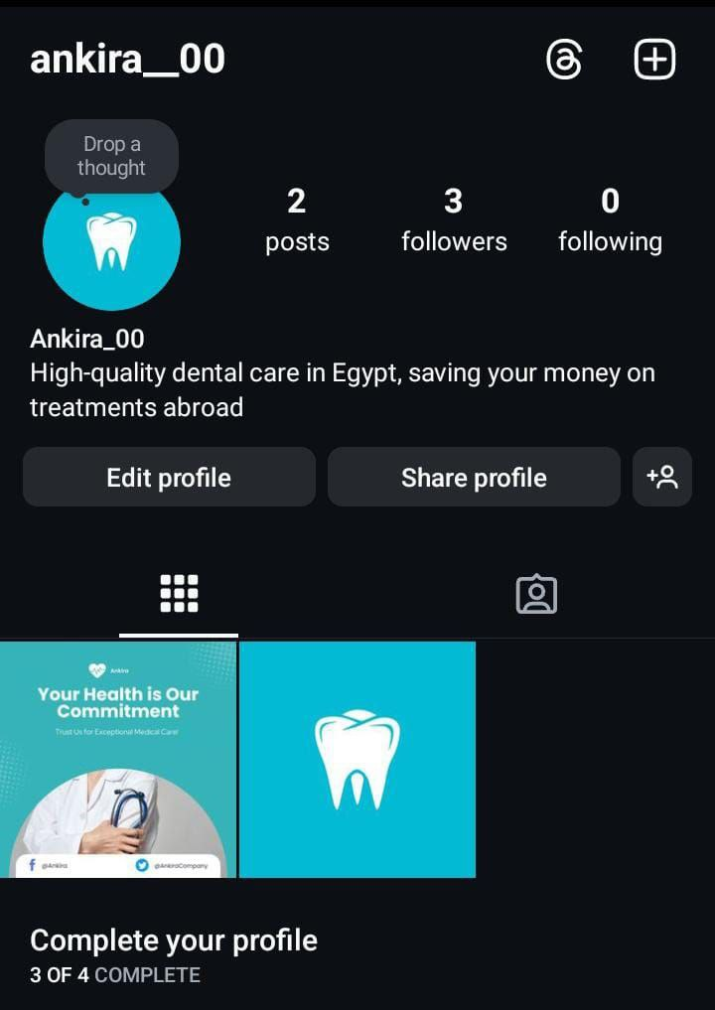
OUR SOCIAL MEDIA CHANNELS
X
TIKTOK
INSTAGRAM

Slide 26
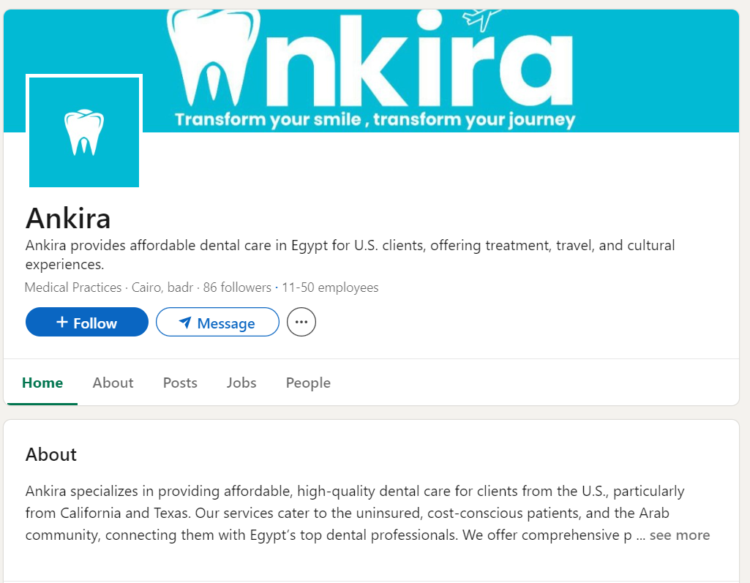
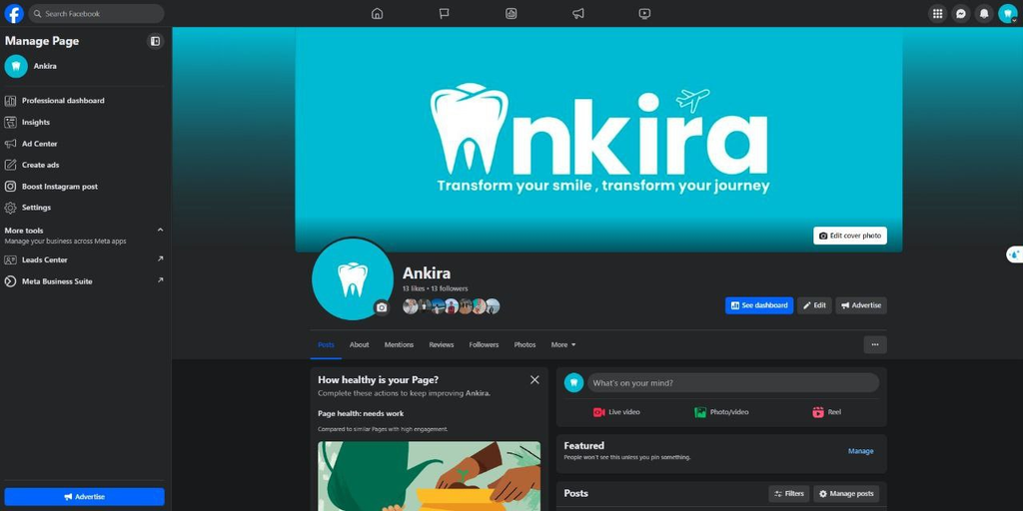
OUR SOCIAL MEDIA CHANNELS
LINKEDIN
FACEBOOK

Slide 27


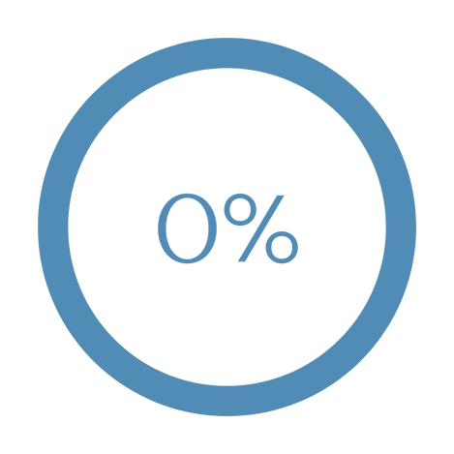

Key Performance Indicators
Reach and Awareness
Engagement Metrics
Conversion
Audience Growth Rate
Social Media Engagement
How many clients did we get

Slide 28
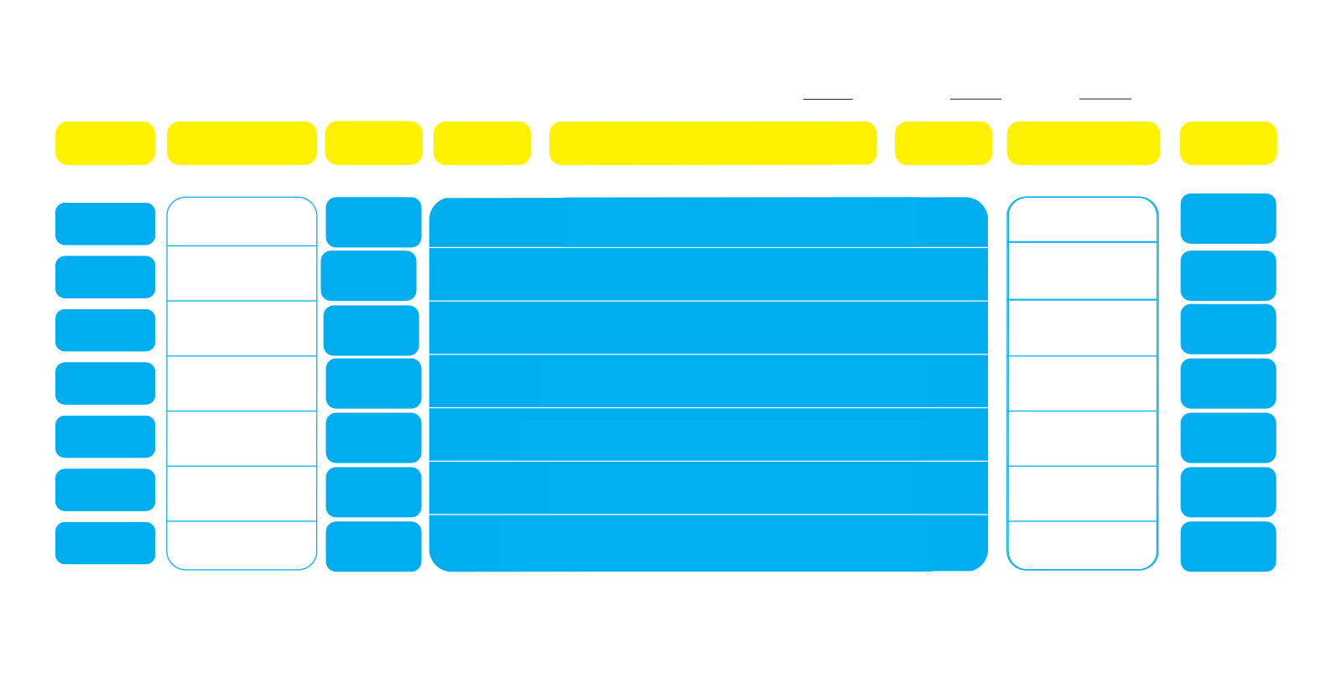
Ankira Weekly Content Calendar
Week:
1
Month:
10
Year:
2024
Day
Platform/Time
Content
Visual
Caption
Hashtags
Goal
Type
Sunday
Facebook
12:00 PM
Post
Eye catching photo
Are you struggling with dental issues and not sure where to
BrandAwarness
find the right treatment? + Long written post
instagram
Monday
12:00 PM Facebook 4:00Pm
Post
Attractive image
A b.eautiful smile starts with teeth care + long written post
Increase Engagment
Facebook
discussing how bad teeth can affect self-confidence.
Increase
Engagment
Tusday
7:00PM
Post/story
Short video
X + Tiktok 8pm+9pm
Tweet/video
Quick video showing someone in pain from a dental issue, then getting treatment in our clincs, with the caption: "Tired of dental
Enhance Interactivity
Wednesday
video
Insta
Linkedin
problems? Try dental treatment in Egypt with Ankira!
Story poll
Poll+Article
Do you have any dental issues? Yes/No + Short article on how
Thursday
improving your smile can boost your confidence.
Increase
8pm+8am
Post with an image of treatment at the clinic: "At
Engagement
Friday
Facebook
Reel
Post
post discussing the importance of dental care at work: "Does your
Increase Engagment
8:00pm
Ankira, we offer the best dental care services in Egypt.
BuildBrand
Lifestyle
Saturday
Linkedin
post
Post
dental health impact your work performance?"
10:00am

Slide 29



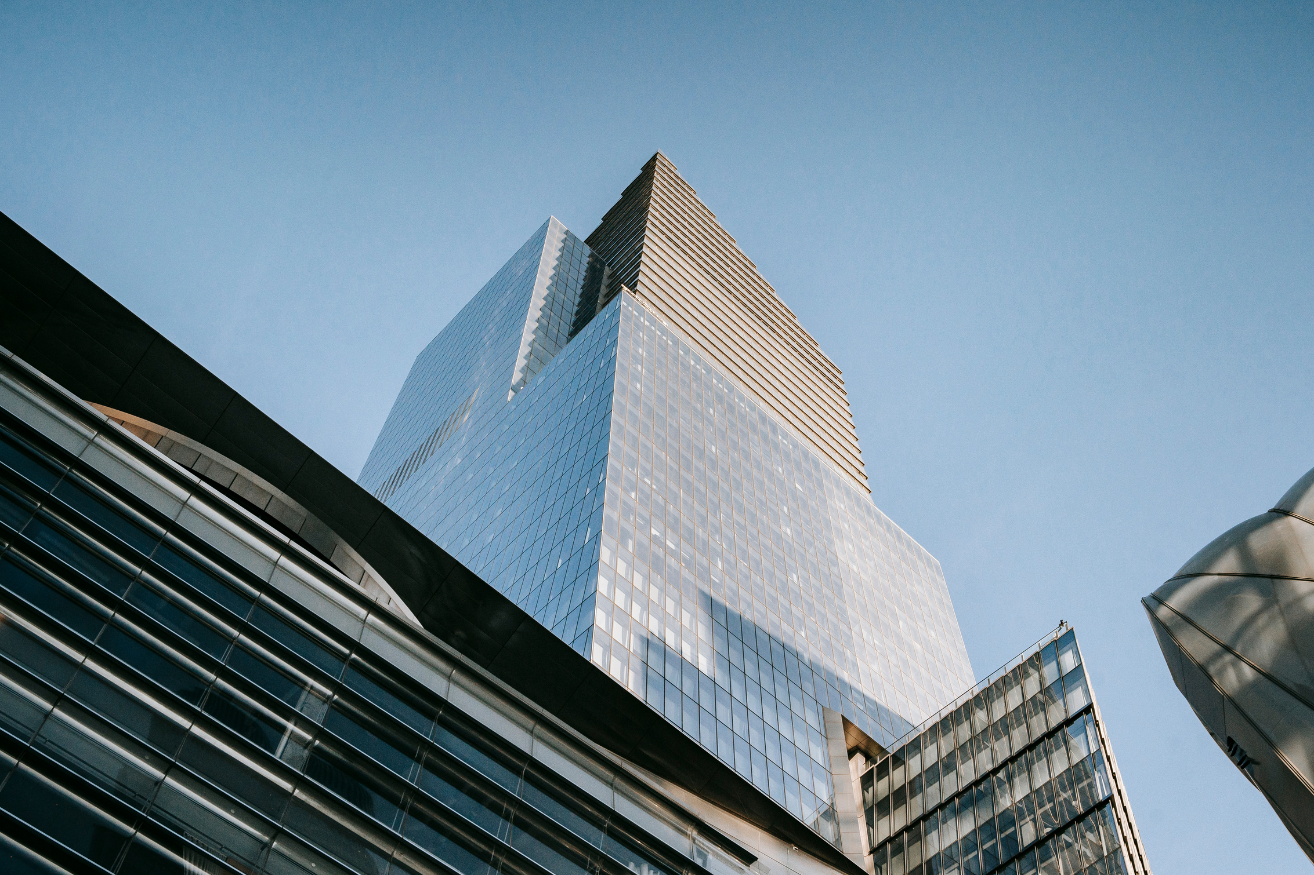
OUR
LANDING PAGE

Slide 30
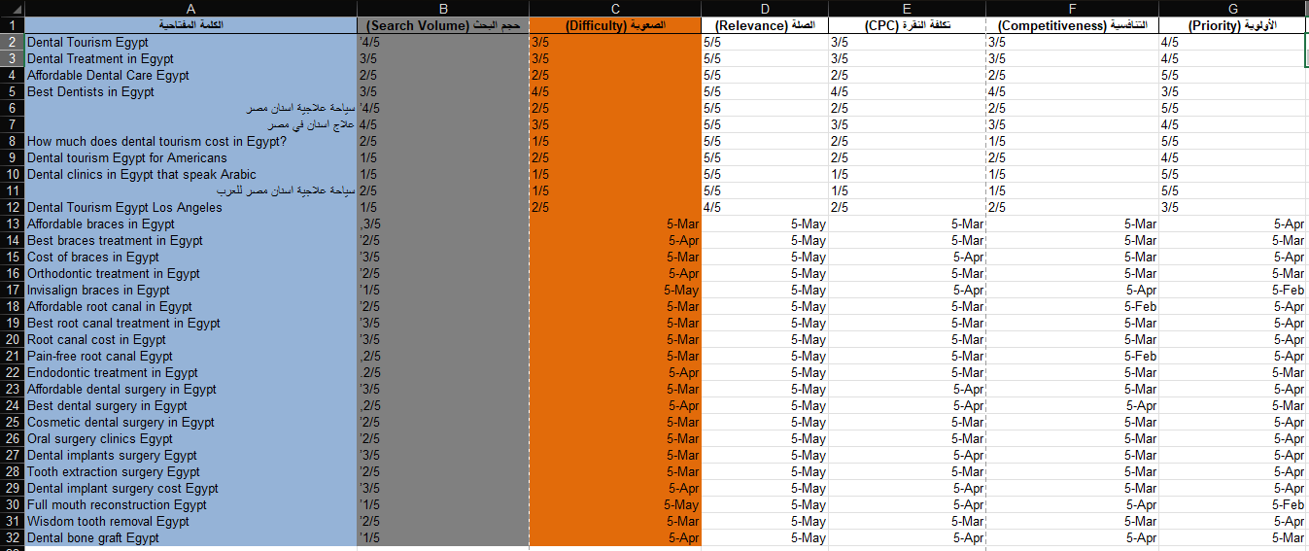
keyword research
حصل بس لخبطة والأرقام اتكتبت كتواريخ لكن الشهر هو التقييم من 5
excel sheet here

Slide 31
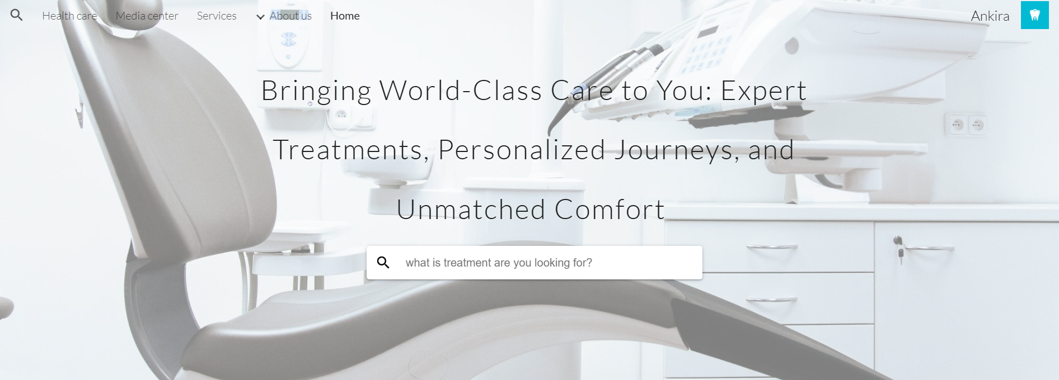

Slide 32
MOBILE APP

Slide 33
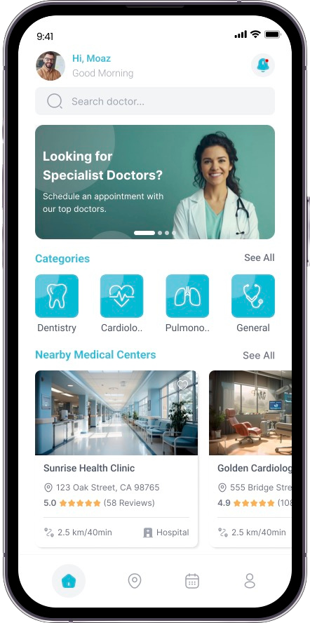

Ankira co.
01
Clearly articulated benefits as they relate to your target audience.
Smartphone (APP)
02
You can use a features and benefits list or just walk through them.
Clearly describe your product in terms that your audience will understand.
03
Whatever you do, do not forget the benefits! They may be obvious to you.

Slide 34
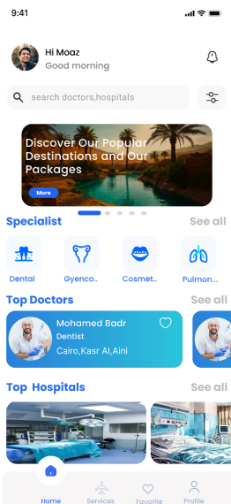
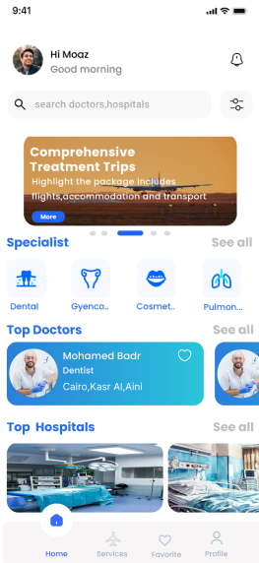
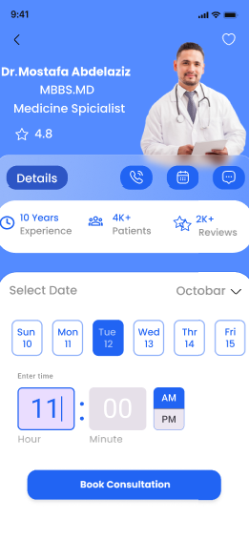

Slide 35
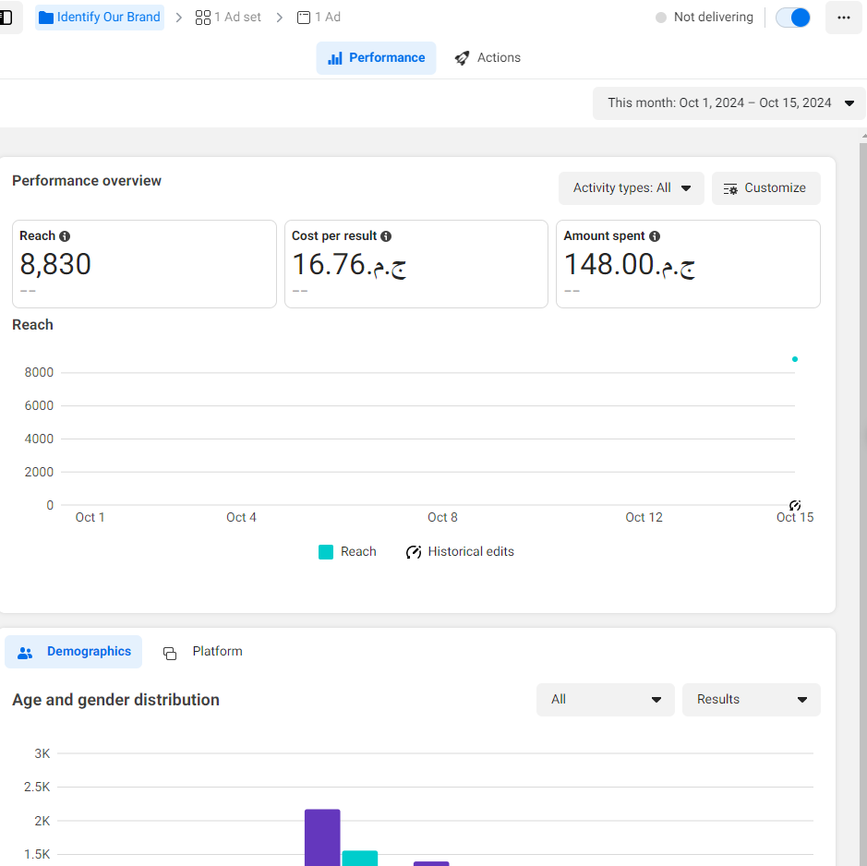
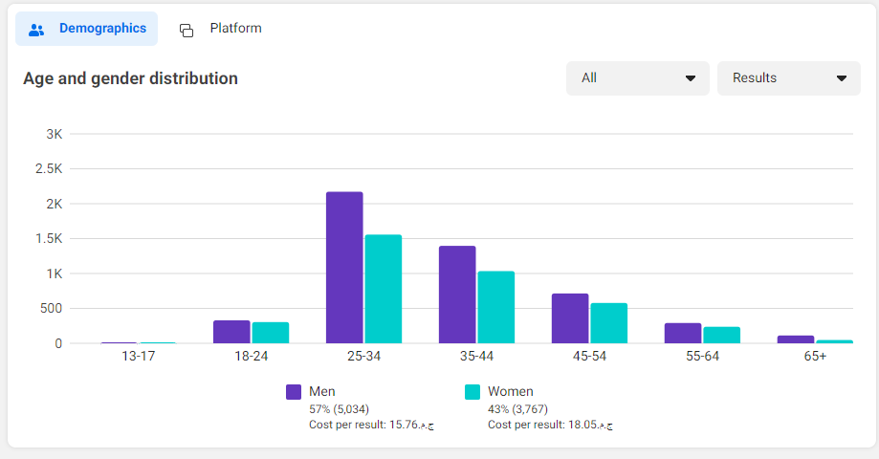
Facebook Ads Reports

Slide 36
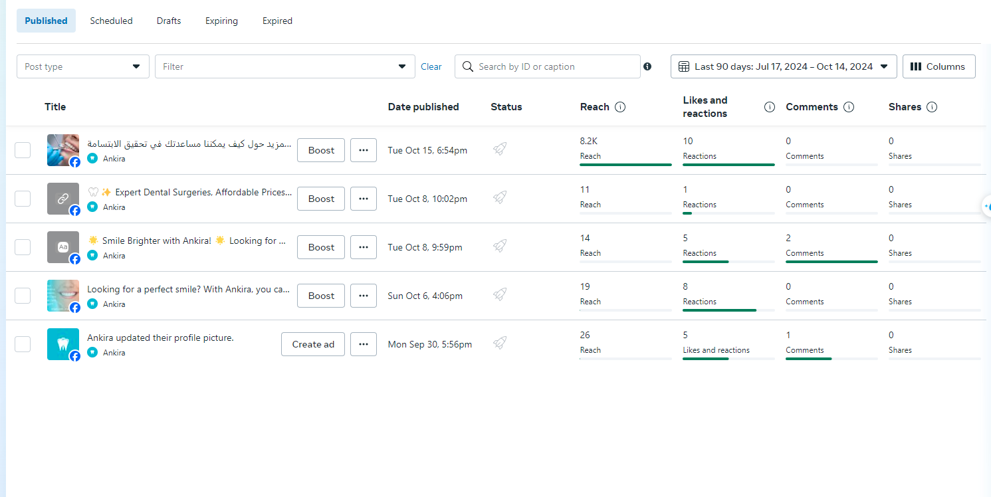
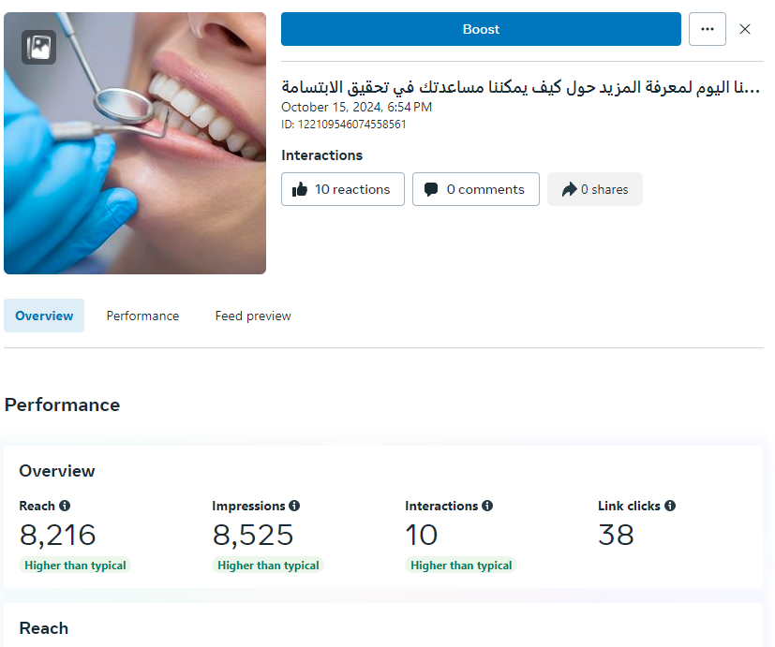

Slide 37

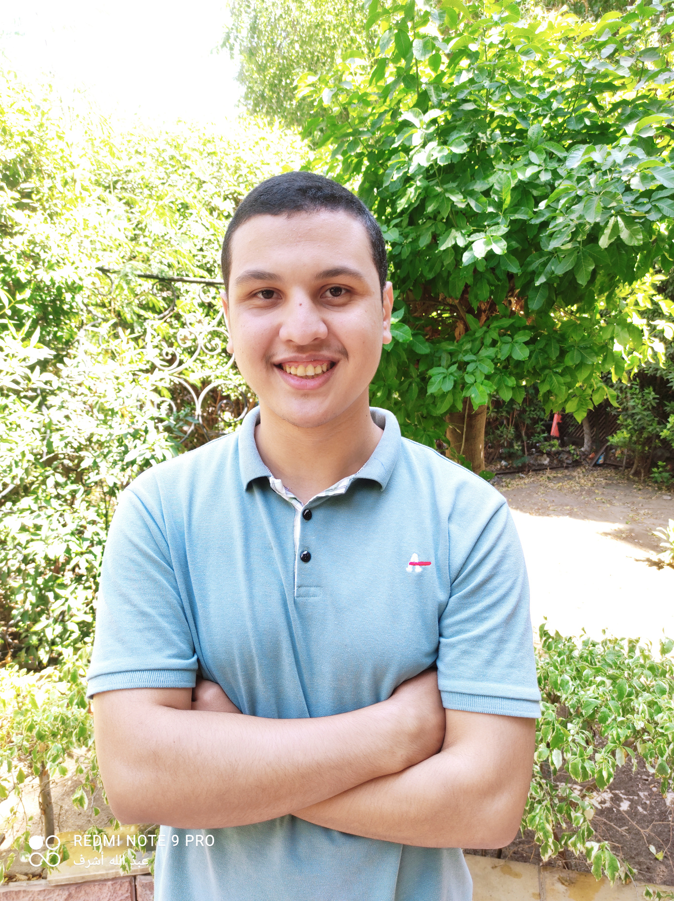
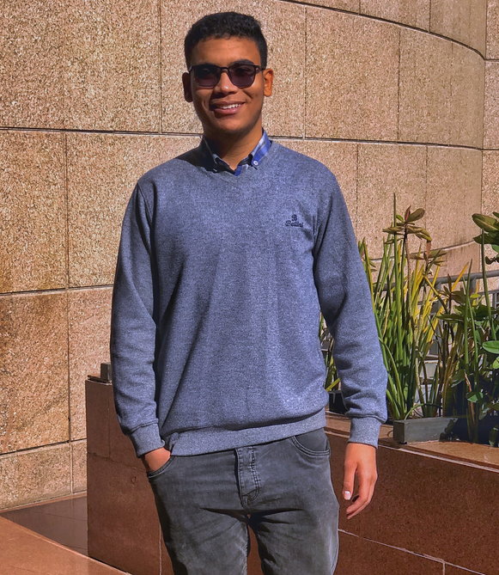
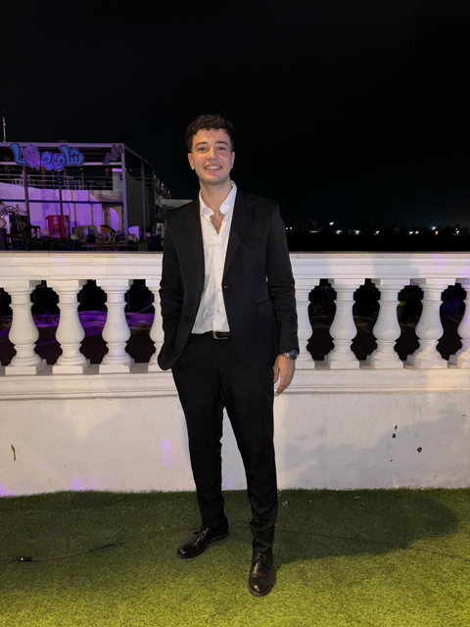
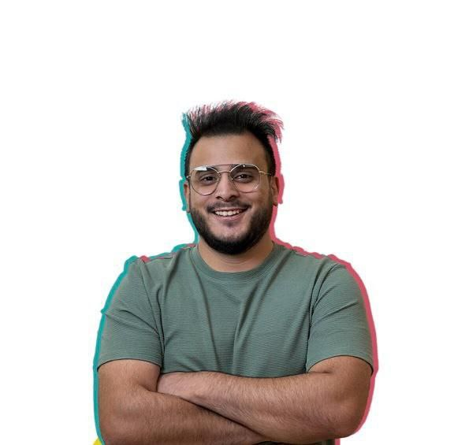
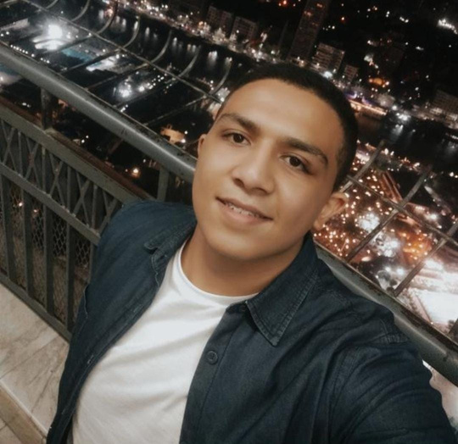
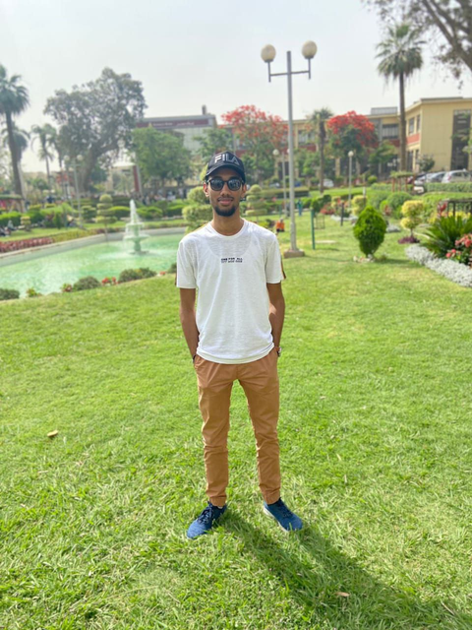


Ankira Co. | 2024
Meet Our Team
Abdullah Ashraf
Ahmed Saad
Mahmoud Sameh
Yousef Hamdy
Marwan Raslan
Omar Ashraf

Slide 38
THANK YOU

